Slide 1

SAP Analytics cloud training
Anurag Bajaj
Shubham Singh
Day 11

Slide 2
Agenda – Day 11
Understanding advance Designer Concepts
Working with Scripting Hierarchies
Transfer Context
Integrate Stories
www.anubhavtrainings.com

Slide 3

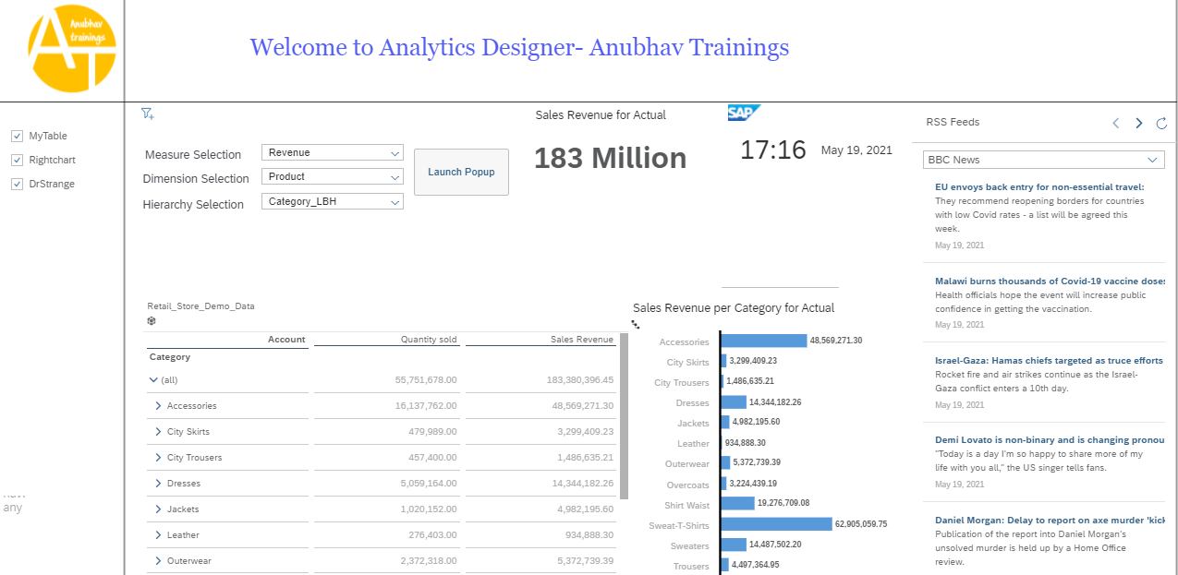
Creating Analytic Designer Application
www.anubhavtrainings.com

Slide 4
End of Day 11

Slide 6

Questions

Slide 7

Anurag Bajaj
anurag.bajaj02@gmail.com

